Slide 1
CS8803-EMS Project Email + Residential ISPs
Vedika Bang + Brian Teachout
6 December 2022
Notes:
Mention names + project

Slide 2
Motivation
How hard is it to send emails from a residential internet connection?
Privacy.
no one else has the opportunity to look at your messages or advertise alongside them.
In an added bonus, your email will keep working even when Gmail, Outlook, or iCloud happens to be down.
Why Hillary Clinton’s E-Mail Server Is Less Odd Than You Think
Spammers and phishers
Notes:
We tested how difficult it is to send emails from a residential internet connection
This is interesting for discussing spam or if you want to run an email server at home.

Slide 3
Motivation – Problem and Questions
How hard is it to send emails from a residential internet connection?
It is arduous, hard yet rewarding.
What limitations are applied by the ISP?
Your deliverability is only as strong as your weakest sender.

Slide 4
Approach – Our Approach
This is largely an experimental study.
Try to send emails from our residential connection.
Go from well configured => poorly configured
Record Observations
Notes:
We did our testing by sending emails from our server, starting with well configured and going to poorly configured

Slide 5
Approach – How Our Approach is Different
It probably is not novel, but there hasn’t been much recent work in the space where rate of false positive is negligible.
Examination based on policy filtering
It is practical and our results speak volumes for criteria set by the spam filters of prominent email servers.
Notes:
This isn’t entirely novel, but not a lot of work has happened recently along these lines specifically.

Slide 6
Results: What Restrictions are applied by the ISP?
We Tried:
Xfinity
Google Cloud, AWS*, Azure, Linode
Port 25 (SMTP + SMTP Exchange) is blocked. A lot.
Why? Ports 465 and 587 are preferred:
Messaging, Malware and Mobile Anti-Abuse Working Group (M3AAWG)
Internet Engineering Task Force (IETF)
Also restricted (reportedly):

Slide 7
Implementation: Our Test Setup
Connection: Small Rural Wireless Internet Service Provider (WISP)
They don’t block Port 25!
No IPV6
No Port Forwarding
No PTR Records
Server Setup
Postfix
Dovecot
Security Services
Webmail

Slide 8
Implementation: DNS + Email
Sender Policy Framework
Domain-based Message Authentication, Reporting & Conformance
SPF: Who can send mail for my domain?
DMARC: What if the email isn’t from me?
DomainKeys Identified Email
DKIM: How do you know the mail is from my server?
Standard Records: A, AAAA, MX
Configured at the Domain (us)
Pointer Record: Reverse DNS
PTR: What domain does this IP belong to?
Configured at the ISP (not us)

Slide 9
Domain-based Message Authentication, Reporting & Conformance
Sender Policy Framework
SPF: Who can send mail for my domain?
DMARC: What if the email isn’t from me?
DomainKeys Identified Email
DKIM: How do you know the mail is from my server?
Standard Records: A, AAAA, MX
Configured at the Domain (us)
Pointer Record: Reverse DNS
PTR: What domain does this IP belong to?
Configured at the ISP (not us)

Slide 10
Implementation: Our Tests
Correct
Not Configured
Incorrect
Classifying Results
Delivered: Inbox or Spam
Rejected: Error vs No Error
TESTS | DMARC | DKIM | SPF | Other DNS Records
Test 1
Test 2
Test 3
Test 4

Slide 11
 | DMARC | DKIM | SPF | Other DNS Records
Test 1
Test 2
Test 3
Test 4
Configured and Matches
Not Configured
Configured and Does Not Match

Slide 12
 | Test 1 | Test 2 | Test 3 | Test 4
GMAIL | inbox | spam | rejected | rejected
Yahoo | inbox | spam | inbox | spam
Yandex | rejected | rejected | rejected | rejected
Proton | inbox | inbox | inbox | inbox
Outlook | rejected | rejected | rejected | rejected
GMX | rejected | rejected | rejected | rejected
Tutanota | rejected | rejected | rejected | rejected
AOL | spam | inbox | spam | spam

Slide 13
Retrospective
How was it different/harder than expected?
Finding an Internet connection for testing was more difficult than expected.
Getting email into inbox was easier than expected.
What would you do different?
Diversify the sending addresses

Slide 14
What remains to be done?
Conduct a second round of testing with unique email addresses.
Try AWS unblocking again.

Slide 15
References/Resources
Xfinity - https://www.xfinity.com/support/articles/email-port-25-no-longer-supported
IETF RFCs
https://www.rfc-editor.org/rfc/rfc5068
https://www.rfc-editor.org/rfc/rfc4409
M3AAWG Paper - https://www.m3aawg.org/sites/default/files/document/MAAWG_Port25rec0511.pdf
AirFi - https://www.airfi.today/
iRedMail - https://www.iredmail.org/index.html
Google Domains - https://domains.google.com/registrar/
Port Testing - http://portquiz.net/
Email/DNS Checking
https://toolbox.googleapps.com/apps/checkmx/
https://mxtoolbox.com/emailhealth/mail.bvemail.net/
https://www.dmarcanalyzer.com/dkim/dkim-checker/
https://dkimvalidator.com/
Gmail Deliverability - https://support.google.com/mail/answer/81126?hl=en
Email Server Configuration - https://arstechnica.com/information-technology/2014/02/how-to-run-your-own-e-mail-server-with-your-own-domain-part-1/

Slide 16
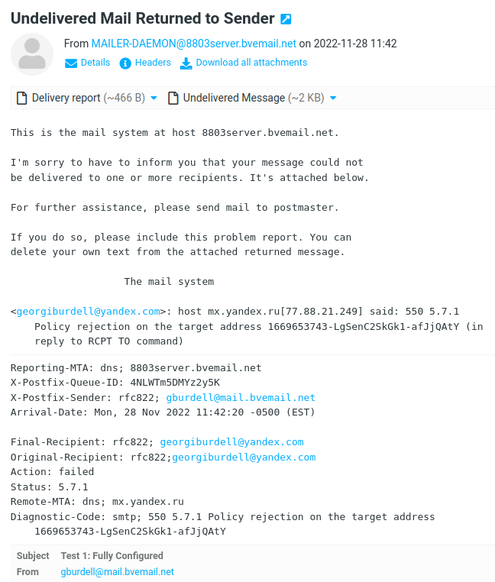
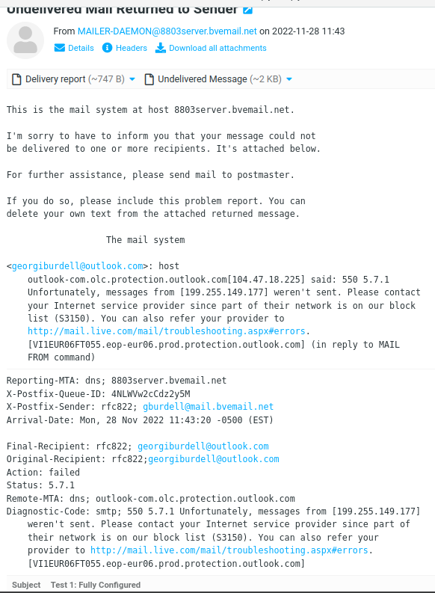
Errors - Yandex, Outlook

Slide 17
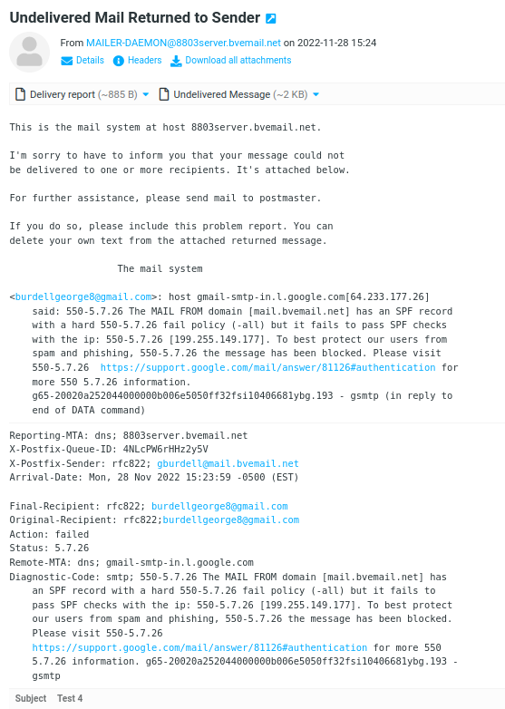
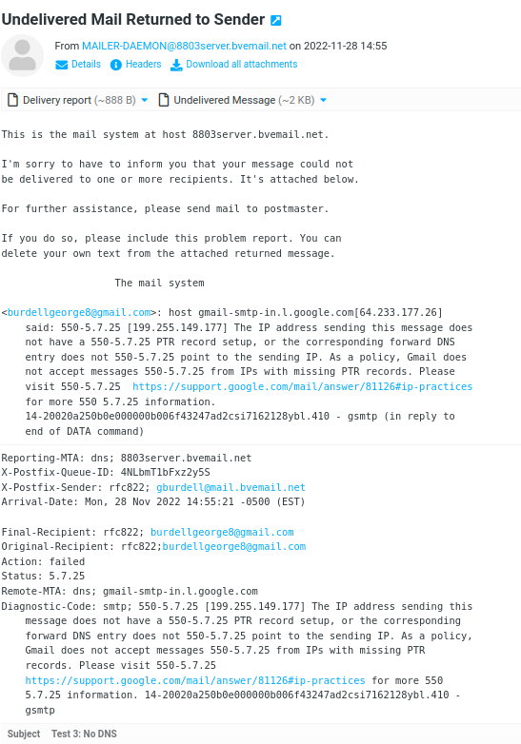
Errors - Google

